Slide 1
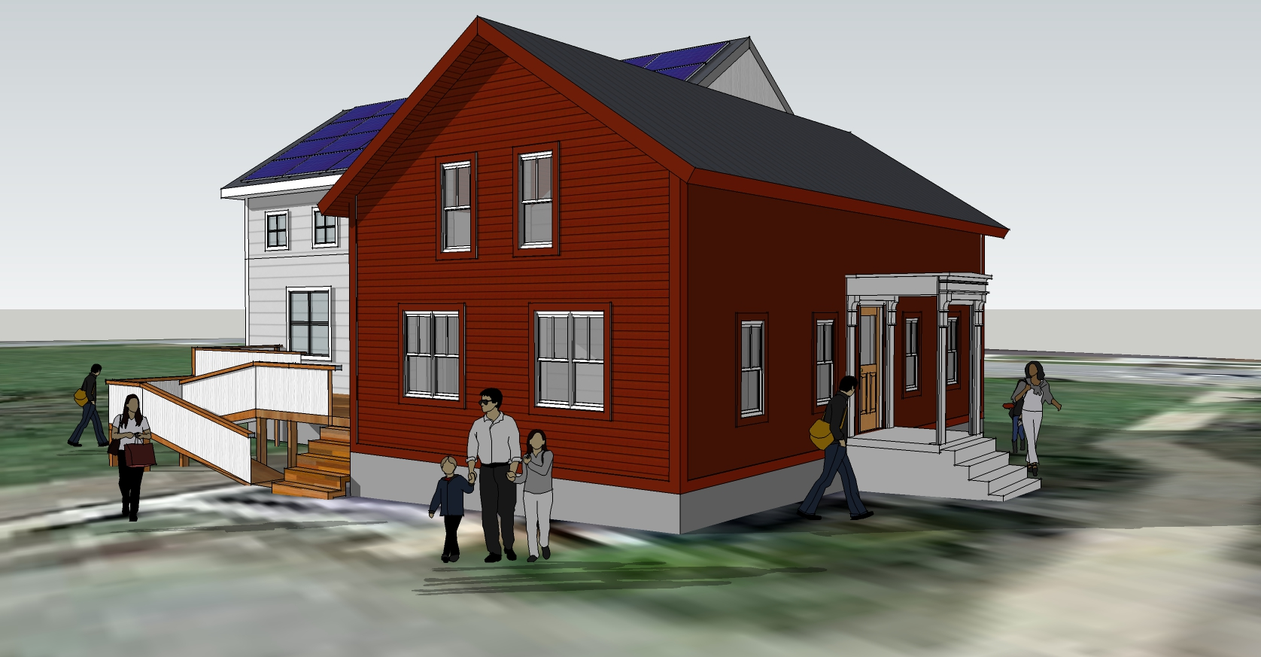
Financing Workshop: Overview of Financing Products Better Buildings Summit May 17, 2017
Chris Kramer, Energy Futures Group

Slide 2
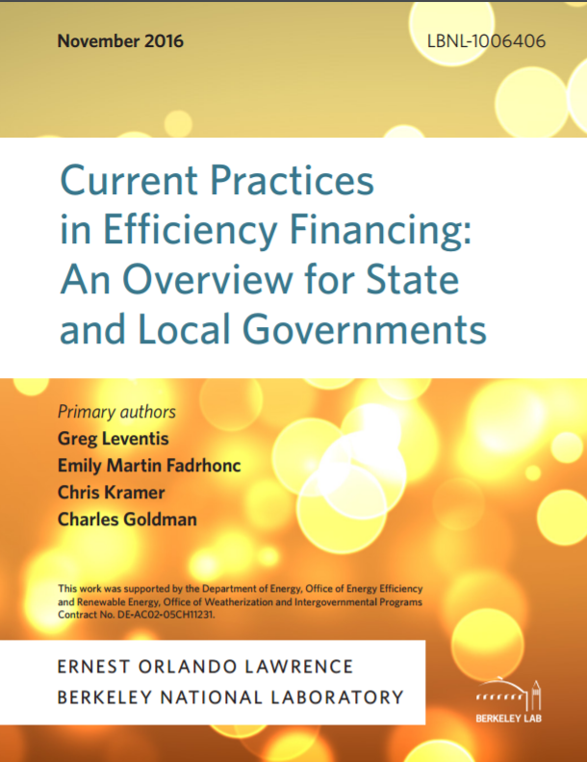

Slide 3
Barriers to Energy Efficiency Investments
Awareness/Information
Total Cost
Hassle
Competing Priorities
Uncertainty of Savings
Distrust
Access to Financing
Split Incentives
Health and Safety
Aesthetics
Notes:
These are just examples; there are others.
Takeaway is that access to financing is just one in a long list of market barriers that must be addressed in order to encourage more energy efficiency investment.
Need other program features (marketing and education, incentives, technical assistance, etc.) to address non-financing barriers.

Slide 4
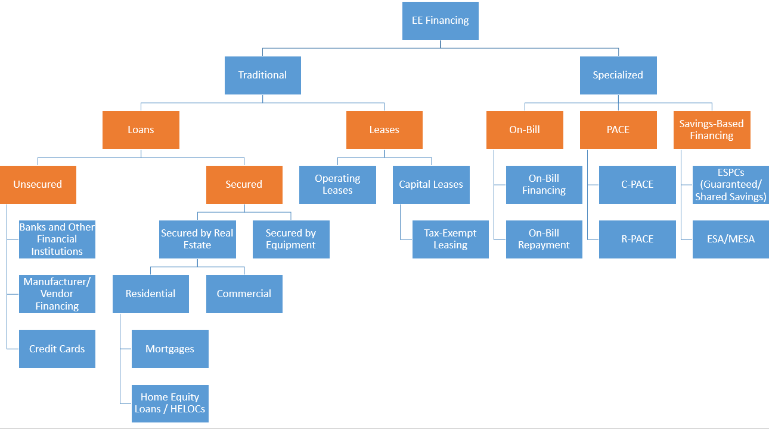
Financing Product Overview
Notes:
Orange boxes correspond to column headings on next slide.
Main takeaway: all these financing options fit on one slide, so this world is more accessible than you might think.

Slide 5
Product Features: Special Features/Basic Features
 | MARKET BARRIER | UN-SECURED | SECURED | LEASING | ON-BILL | PACE | PERFORM-BASED
Special Features | Access to Capital | ~ | ~ | ~ | ✓ | ~ | ~
 | Cash Flow | ~ | ✓ | ~ | ~ | ✓ | ✓
 | Payback Period | X | X | X | ✓ | ✓ | ~
 | Debt Limits | X | X | X | ~ | ~ | ✓
 | Split Incentives | X | X | X | ~ | ~ | X
Basic Features | Familiarity | ✓ | ✓ | ✓ | ~ | X | X
 | Complexity | ✓ | ~ | ✓ | ~ | X | X
 | Convenience | ✓ | ~ | ✓ | ✓ | X | X
 | Admin Costs | ✓ | ~ | ✓ | X | X | X
Notes:
Special features = product designs intended to address specific market barriers.
✓= strong on this feature. ~ = in between. x = weaker on this feature.
These are rules of thumb. Credit enhancement, design tweaks, investments in education, etc. can improve products along these dimensions.

Slide 6
Markets and Financing Barriers
Market Barrier | Single Family (Market Rate) | Single Family (Low-Mod Income) | Multi-Family (Market Rate) | Multi-Family (Low-Mod Income) | Small Business | Large Business | Muni, Uni, Schools, & Hospitals (MUSH)
Access to Capital
Cash Flow
Payback Period
Debt Limits
Split Incentives
Notes:
Red = More of a barrier; Yellow = In between; Green = Less of a barrier

Slide 7
Features Specific to Each Jurisdiction
Market Features | Specific Considerations
Customer Characteristics | Target Market/Sub-Segment Income Levels Access to Credit Debt Capacity
Building Characteristics | Building Stock Ownership Structure
Program Environment | Available Capital Financial Partners Utility Programs Other Available Resources Enabling Legislation (PACE)

Slide 8
Q&A
Chris Kramer
Energy Futures Group
ckramer@energyfuturesgroup.com
Phone: 802-482-5001 x4

Slide 9
APPENDIX 1: Capital Sources

Slide 10
Potential Capital Sources
Public
Utility
Private
Hybrid

Slide 11
Capital Sources: Federal Public Funding
USDA:
Energy Efficiency and Conservation Loan Program: Low-interest loan program for utilities serving rural areas (pop. <20K)
Rural Energy Savings Program: 0% interest loan program for utilities serving rural areas (pop. <20K); $52M available
HUD: Community Development Block Grant:
Formula block grants to local jurisdictions (plus a few additional programs).
Energy efficiency is an eligible use of funds and can be used for loan programs.
Must apply through local jurisdiction; some have formal application processes, others use open solicitations.
Eligible activities: Larger Communities (Sec. 5.10); Smaller Communities (Ch. 2)
EPA: Clean Water State Revolving Fund
Funds state agencies primarily for large clean water infrastructure projects
Some of these agencies have invested in EE programs that reduce pollutants
Requires establishing a formal partnership with clean water agency
Examples: PA (PENNVEST/Keystone HELP); NY (NYSERDA/NY EFC)
Notes:
CWSRF: Energy efficiency--Assistance to any municipality or inter-municipal, interstate, or state agency for measures to reduce the energy consumption needs for publicly owned treatment works.
CDBG—potential program areas: Entitlement Communities, State Administered CDBG, Section 108 Loan Guarantee, and Neighborhood Stabilization
EECLP—Open to utilities serving towns or unincorporated areas with <20K residents
RGGI—CT, DE, ME, MD, MA, NH, NY, RI, AND VT
CHANGE TO MATRIX

Slide 12
Capital Sources: State/Local Public Funding
State and Local Agencies
State and Local Energy Offices Example: Nebraska Energy Office “Dollar and Energy Savings” Loans
State and Local Housing Authorities Example: Minnesota Housing Finance Agency
State and Local Economic Development Agencies Example: Iowa Economic Dev. Authority and City of Dubuque
Qualified Energy Conservation Bonds (accessed through local/state agencies; federal subsidy reduces cost, but process can be complex)
Regional Sources
Regional Greenhouse Gas Initiative (Northeast) (e.g., NYSERDA)
Other Regional Funds (e.g., Southeast Energy Efficiency Fund)
Other Resources
Repurposed ARRA funds
VW settlement funds? (still unclear)
Notes:
CWSRF: Energy efficiency--Assistance to any municipality or inter-municipal, interstate, or state agency for measures to reduce the energy consumption needs for publicly owned treatment works.
CDBG—potential program areas: Entitlement Communities, State Administered CDBG, Section 108 Loan Guarantee, and Neighborhood Stabilization
EECLP—Open to utilities serving towns or unincorporated areas with <20K residents
RGGI—CT, DE, ME, MD, MA, NH, NY, RI, AND VT

Slide 13
Capital Sources: Utility Funding
Examples:
Energize CT Heating Loan
Midwest Energy’s How$mart Kansas (hybrid)
SC Help My Home (hybrid)
Factors to consider:
Ratepayer-funded
Requires utility cooperation
Typically (but not always) repaid on-bill
Flexibility in interest rate and other terms
Consumer protection issues (disconnection, etc.)
Other regulatory issues

Slide 14
Capital Sources: Private Debt (“Market-Based”)
Banks
Example: TVA Energy Right Solutions (Regions Bank)
Crowd sourcing / Fin tech
Example: Connecticut Green Bank – Sungage/Mosaic
Specialized Clean Energy Capital Pools
Examples: WHEEL (hybrid)
Notes:
Important issues: CRA obligations, loan tenors

Slide 15
Capital Sources: Private Debt (“Mission Driven”)
Mission-driven
Credit Unions
Examples:
Mass Save HEAT Loan (utilities + ~80 local banks/credit unions)
Smart-E (CT) (CT Green Bank + 11 credit unions and local lenders)
Community Development Financial Institutions
Examples:
Craft3 (OR, WA) (Enhabit Program)
Capital for Change (CT) (Energy Conservation Loan Program—income-tiered interest rates)
Solar and Energy Loan Fund (FL)
Foundations
Examples:
Bank of America Foundation
MacArthur Foundation
Notes:
Important issues: CRA obligations, loan tenors

Slide 16
Capital Sources for Solar Projects
Debt and Equity Sources
Solar projects look to different of sources of capital to finance a project
Tax equity is currently the most expensive source of capital and debt is the cheapest
Equity Investments have historically come from large investment banks, or other corporate entities looking to lower their tax bills, as the investor will claim the majority of the Investment Tax Credit.
Debt is a much more flexible source of capital that can come from a variety of organizations (e.g. banks, gov’t loans, institutional investors).
An experienced developer will use different sources of capital to maximize both profits and incentives.
Source: Feldman, D.; Lowder, T.; Schwabe, P. 2016. Terms, Trends, and Insights PV Project Finance in the United States, 2016. NREL. September 2016.

Slide 17
Issues and Tradeoffs
 | PUBLIC | UTILITY | PRIVATE
AVAILABILITY | Lower | Medium | Higher
COST | Lower | Lower | Higher
FLEXIBILITY | Higher | Higher | Lower
SCALABILITY | Lower | Lower | Higher
Hybrid capital pools can help address these tradeoffs, but may introduce complexity.

Slide 18
APPENDIX 2: Finance Primer

Slide 19
Finance Primer
The Goal of the this Short Presentation is to Describe the Who and How of EE Finance Programs
Notes:
In order to tell you how to do it, we will tell you who does what and then add the bells and whistles

Slide 20
FINANCE: A Means to Get Money from a Capital Provider
To a Customer
— and Back from the Customer Over Time
Capital Provider
$$
$$
Customer
Notes:
In order to tell you how to do it, we will tell you who does what and then add the bells and whistles

Slide 21
CAPITAL PROVIDER It All Starts with the “Who”
Questions to Consider
Whose money are you deploying? (sometimes more than 1 source)
What is the purpose or mission of the money?
How much money do you have?
How much money do you need?
What is the risk associated with the money?(credit, interest rate, and counterparty risk)

Slide 22
Who Manages the Flow of Money?
Capital Provider
Originator
$$
$$
Customer
Notes:
In order to tell you how to do it, we will tell you who does what and then add the bells and whistles

Slide 23
AN ORIGINATOR:
Takes in the financing application
Underwrites the application (pulls credit scores, files liens if necessary etc.)
Creates and documents the finance instrument.
A finance instrument is a contract to pay back capital over time. Typically a loan, a lease or a service agreement (eg. a tariff)
This obligation MUST comply with all applicable regulations and laws.
Who originates? Regulated financial institutions (credit unions, banks, CDFIs) OR 3rd party originators (WECC, AFC First)

Slide 24
Who Manages the Flow of Money?
Capital Provider
Originator
Servicer
$$
$$
Customer
Notes:
In order to tell you how to do it, we will tell you who does what and then add the bells and whistles

Slide 25
SERVICER
A servicer calculates payments due, adjusts payments due/dates due in the case of pre-payments, tracks/reports on delinquencies, addresses charge-offs, collections after charge-off, provides reporting etc.
Complies with relevant lending laws and regulations.
Who services? Regulated financial institutions (credit unions, banks, CDFIs) OR 3rd part servicers. (They don’t have to have their own capital)

Slide 26
What About Utility On-Bill Programs?
Capital Provider
Utility or 3rd Party
Servicer
Originator
Utility
Utility
$$
$$
Customer
Notes:
In order to tell you how to do it, we will tell you who does what and then add the bells and whistles

Slide 27
What About PACE Programs?
Capital Provider
PACE Specialty Investor
Servicer
Originator
Local Gov’t
Local Gov’t or 3rd Party
$$
$$
Customer
Notes:
In order to tell you how to do it, we will tell you who does what and then add the bells and whistles

Slide 28
What Role for the Gov’t or Utility?
Capital Provider
Warehouse
Backstop
Originator
Servicer
$$
$$
Invoicing
Customer
Notes:
In order to tell you how to do it, we will tell you who does what and then add the bells and whistles

Slide 29
Conclusion
EE finance invokes a limited universe of functions.
EE finance is unique in that it can overlay these functions with other non-finance servicing, origination or capital provision.
The roles of utilities or governments can vary tremendously based on financial, personnel and other resources, policy goals, tolerance for risk etc.

Slide 30
Resource Sides

Slide 31
BELLS & WHISTLES Warehouse
A means to access additional capital:
Originate a pool of loans, put them into a “warehouse” and then sell them to an investor(s).
$$$
* Investors do not want to buy every loan in a portfolio, they want yield related to risk. Every loan they buy has to comply with 1) their return expectations and 2) regulations regarding what they can hold on their books. If there is a mis-match, there will need to be a credit enhancement…

Slide 32
BELLS & WHISTLES Credit Enhancement
A credit enhancement supports backstops a bundle of financing and provides assurance that the capital provider will be repaid.
Credit enhancements reduce credit/default risk and expand underwriting and reduce interest rates or lengthen term.
Come in a variety of forms:
Loss reserves
Guarantees.
Credit enhancements make investors willing to purchase bundles of loans that they otherwise would not consider purchasing.

Slide 33
Spectrum of Utility Roles in On-Bill Programs
On-Bill Finance
(utility operated, utility risk, utility capital)
3rd Party Bill
(utility capital)
3rd Party Bill
(utility capital/warehouse)
3rd Party Bill
(utility capital -credit enhancement)
On-Bill Invoice
3rd Party Bill – 3rd party originates and services
The graphic illustrates the spectrum of options for utility engagement in efficiency financing (only one of which involves a utility engaging in all three roles of providing loan capital, origination and servicing).

