Slide 1
Growing the Pie? Assessing Financing’s Achievable Savings Potential August 23, 2016
Chris Kramer, Energy Futures Group

Slide 2
Energy Futures Group Consulting
Areas of Expertise
Policy Development
Program Design
Building Codes
Evaluation
Cost-Effectiveness
Range of Clients
Government Agencies
Advocates
Regulators
Utilities
Clients in 30 states/provinces plus regional, national and international organizations.

Slide 3
Presentation Overview
Financing Potential from a “Technical” Perspective
Financing Potential from an “Addressable” Perspective
Financing Potential from an “Achievable” Perspective

Slide 4
Technical Potential
United States:
Deutsche Bank/Rockefeller Model

Slide 5
Technical Potential: U.S. Deutsche Bank/Rockefeller Model
Energy Savings (Annual Tbtu)
Total Investment ($Bn)
Bottom line:
“Scaling building energy efficiency retrofits in the United States offers a $279 billion dollar investment opportunity.”

Slide 6
Technical Potential: Implications
“Implications for Policy”
(How do we get there, according to DB/Rockefeller?)
Mandates (targets) that set comprehensive energy efficiency standards
Disclosure requirements
Leadership by example
Subsidies, incentives and guarantees to ‘de-risk’ energy efficiency investments

Slide 7
Addressable Potential
New York:
Booz & Co. Model

Slide 8
New York Model: Technical Potential
Source: Booz 2013

Slide 9
New York Model: Green Bank “Addressable” Potential
Source: Booz 2013

Slide 10
Addressable Potential: Implications?

Slide 11
Achievable Potential
California:
Navigant Model

Slide 12
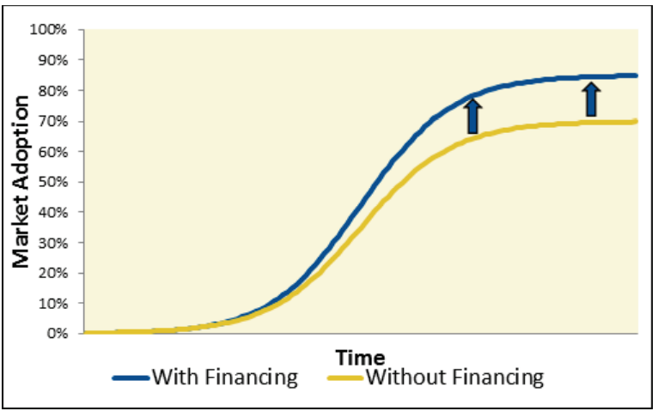
Achievable Potential: CA Model
Source: Navigant

Slide 13
Achievable Potential: CA Model
Source: Navigant

Slide 14
Achievable Potential: California Navigant Detailed Approach

Slide 15
Achievable Potential: California Inputs and Sources
Inputs included:
Past survey results
Observations from financing programs in California and other states
Expert interviews
Literature research
Process evaluation of California’s small business On-Bill Financing Program

Slide 16
Achievable Potential: California Findings from Background Research
Research findings included:
Financing may enable, rather than drive, demand
Complementary strategies are needed to overcome wide range of EE barriers
Program design parameters may impact saving and participation rates
Private financing may be readily available to customers in some markets
Financing itself may sometimes introduce additional market barriers

Slide 17
Achievable Potential: CA Model
Source: Navigant

Slide 18
Achievable Potential: CA Model
Source: Navigant

Slide 19
Addressable vs. Achievable
Comparing the New York and California Approaches to Estimating Financing Potential

Slide 20
Comparing Approaches to Assessing Energy Efficiency Financing Potential
Jurisdiction | NY | CA
How study was labeled | “Addressable” Potential | “Achievable” Potential
What was projected? | Amount of Capital That Could Be Deployed | Amount of Energy Savings Achieved (Attributable to Financing)
Under what circumstances? | If all possible projects were completed today | In light of market barriers and likely participation in specific financing programs
Bottom-line conclusion | $55 billion could be deployed into energy efficiency financing | 3 – 5% additional savings could be realized by layering financing onto portfolio

Slide 21
Q&A
Chris Kramer, Senior Consultant
Energy Futures Group
Phone: 802-482-5001 x4
ckramer@energyfuturesgroup.com

